Slide 1
Creating an ETL for Medicare Claims
Areas of Improvement
OHDSI Conference Call
January 27, 2015

Slide 2
Overview
OHDSI needs a test dataset that organizations can use to test their implementation of the ETL process, Achilles, and queries against the CDM
There is a Medicare Synthetic data set for exactly this purpose
Medicare data is commonly used in a variety of research settings and is merged with other claims data to provide longitudinal follow up
SEER (oncology registry covering ~27% of the US)
Medicare Virtual Research Data Center (access Medicare data remotely)
Current Medicare Beneficiary Survey
National Center for Health Statistics (only at research data centers)
1999-2004 National Health and Nutrition Examination Survey (NHANES)
NHANES I (1971 – 1992) and III (1988 – 1994)
1994-2005 National Health Interview Survey (NHIS)
The Second Longitudinal Study of Aging (LSOA II, 1994-2000)

Slide 3
Rationale for Developing a Medicare ETL Process
If we can specify a high-quality ETL process for Medicare data, then the use of the CDM could spread to other institutions who work with this data
Each instance of Medicare data might be a little different, but handling those variations should be straight-forward
Enough people have done parts (or all) of the Medicare ETL process or worked with the data directly, that this should be readily accomplished
Truven MarketScan data can also inform this ETL

Slide 4
Medicare Synthetic Data
Known Issues and Considerations

Slide 5
Medicare Synthetic Data Files
Files
Beneficiary Summary
Inpatient Claims
Outpatient Claims
Carrier Claims (Physician)
Prescription Drug Events (Part D)
Years: 2008-2010
http://www.cms.gov/Research-Statistics-Data-and-Systems/Downloadable-Public-Use-Files/SynPUFs/DE_Syn_PUF.html
Each file type is split across 20 files that need to be merged
1/20th sample by patient
Carrier claims are further split into 2 files for each sample
Approximately 2.3 million patients in each year

Slide 6
Medicare Synthetic Data: Our ETL Process
ETL written in SAS for CDM V4
Person
Limited race information
Death
Date but no cause of death (not available)
Visit Occurrence
Place of service type indicated as inpatient, outpatient, or office by file type
Condition Occurrence
Claim diagnoses only
ICD9 diagnosis codes only
Procedure Occurrence
Only included ICD9 procedure and HCPCS codes
Notes:
Used invoice (“claim”) dates as opposed to date of service (“line”)

Slide 7
Medicare Synthetic Data: Things to Note
We have not looked at Part D file
Not all diagnosis and procedure fields filled out contiguously (e.g., first diagnosis code may be missing)
Only get number of months of enrollment in each year, not specific months
Denied claims field is not included for outpatient or inpatient file
Charged amount not included for outpatient and inpatient but is included for physician
No place of service indicator
Beneficiary file contains summary variables
Annual reimbursement and deductible amounts
Chronic Condition Warehouse status indicators (Alzheimer, Heart failure, etc)
http://www.cms.gov/Research-Statistics-Data-and-Systems/Downloadable-Public-Use-Files/SynPUFs/Downloads/SynPUF_Codebook.pdf

Slide 8
SEER Medicare Data
Known Issues and Considerations

Slide 9
SEER Medicare Files
Patient Medicare claims are merged with cancer patients in the SEER registry
Available Files for analysis:
PEDSF – demographics and cancer registry data by patient
MED – Inpatient facility claims
OUT – Outpatient facility claims
NCH – Carrier (aka physician) claims
HHA – Home Health facility claims
DME – Durable Medical Equipment claims
HSP – Hospice Facility claims
PDE – Part D Event file
Years: 1999-2010
All claim files are split by year. The PEDSF includes demographics for all patients included in the claim files.
Access to files require prior authorization from the National Cancer Institute (NCI)

Slide 10
Our ETL for SEER Medicare
ETL written from SAS for CDM v4 for colorectal cancer and acute lymphoblastic leukemia from 1999-2010.
The following files were created
Observation
Each recorded cancer the patient had in the PEDSF file created an observation record.
Visit Occurrence
Each line date on a claim created one visit occurrence record.
Used line dates for all claims when possible – billing dates were used when line dates were not found.
Condition Occurrence
Each icd9 code on a claim created a condition occurrence record.
Used line diagnoses for NCH and DME files – used claim diagnoses for all other files.
Procedure Occurrence
Each hcpcs/icd9 procedure code created a procedure occurrence record.
Inpatient: assigned the surgery date to the procedure code in the procedure occurrence record but linked to visit occurrence record (admit-discharge date aka billing date).
Payer Plan table
Recorded a record for when the patient had both Part A and B coverage as well as HMO coverage.
Observation Period
Created based on the time periods the patient had both Part A and B coverage but no HMO coverage.
Provider File
Only created one provider per physician ID using the NCH and DME files – OUT, HHA, HSP had multiple physician fields and MED did not have any physician numbers.
Patient
From the PEDSF file
Death
From the PEDSF file. Used the Medicare DOD. If missing, used SEER DOD.

Slide 11
Assumptions and Notes for SEER Medicare Data
Each claim file was combined by year for analysis
PDE (Part D Event) file was not used.
Each claim with a unique line/claim date, provider number, and patient created one visit occurrence record.
Removed denied claims and any line information with revenue code 0001 (administration code) from raw data before ETL.
Claims could have multiple provider numbers used to identify one provider. Used the following hierarchy when fields were blank: provider NPI, provider UPIN, provider tax id.
Kept V-codes (ICD9 diagnosis codes that start with a “V”) in the condition occurrence table (though they should be in the observation table?)

Slide 12
SEER Medicare Resources
Documentation for each of the files available through SEER:
PEDSF: http://appliedresearch.cancer.gov/seermedicare/aboutdata/PEDSF.pdf
Claim Files (MED, OUT, NCH, etc): http://appliedresearch.cancer.gov/seermedicare/medicare/claims.html
NCI prior authorization approval guidelines: http://appliedresearch.cancer.gov/seermedicare/obtain/

Slide 13
Medicare 5% Sample
Known Issues and Considerations

Slide 14
Medicare 5% LDS Files - Overview
5% sample of all Medicare patients (~2.5 million patients) per year
We have 2007-2011 data
Denominator – (Patient level data)
DME (Durable Medical Equipment)
HHA (Home Health Agency)
HOS (Hopsice)
INP (Inpatient)
OUT (Outpatient)
NCH (Carrier/Physician)
SNF (Skilled Nursing Facility)
We have not seen the Part D file
2007-2010 share the same structure
2011 has a different structure
Tries to eliminate repeated data by splitting data into multiple files
Ex) NCH file gets split into a claim level dataset and a line level dataset

Slide 15
Medicare 5% LDS Files – Known Issues with Data
Dates:
Data from before 2008 do not include exact date, only the year and quarter
Not possible to supplement
2009 data requires a separate dates file that must be linked into the data
2010+ has exact dates
Similar to SEER-Medicare, we will have to handle identifying physician claims associated with a facility stay
See Resource slide
Need a separate ETL for 2011+ data as it is structured differently
Have not seen 2012 data

Slide 16
Medicare 5% LDS Files - Resources
Videos:
Introduction to the Use of Medicare Data for Research Videos
Articles:
Identifying Physician Claims Associated with a Hospital Stay
ResDAC Articles Related to Medicare
Getting Started with CMS Medicare
Documentation
Web Based Documentation
Excel Documentation
Includes links to what coded values represent in data
Not exact variable name match but close
Institutional Claims Data Dictionary
INP, OUT, SNF, HOS, and HHA
Non-Institutional Claims Data Dictionary
DME and NCH

Slide 17
General etl Issues
Issues that Pertain to All Medicare Claim Files

Slide 18
General ETL Issues with Medicare
Claim vs Line Diagnosis and Dates
What is the difference?
When to use what?
How does this affect the ETL?
Combining facility and physician files
“Same” procedure recorded twice (or maybe there is a difference?)
“Same” diagnoses recorded twice (or maybe there is a difference?)
Some facilities do not have end dates
Skilled Nursing Facility (SNF)
Revenue center codes

Slide 19
Specific etl Issues
Issues that Pertain to All Medicare Claim Files

Slide 20
Claim vs. Line Definitions
Claim Information
Line Information
An invoice the provider sends to the payer
This could include procedures from multiple dates of service
Diagnoses listed are not specifically referenced to a procedure or to a date of service. They apply to ALL of the procedures listed on the invoice.
Terms: claim diagnosis, billing dates
Procedure-level information.
The provider lists what was done to the patient on a day by day basis.
A diagnosis is referenced to that one procedure – Medicare requires one and only one.
Terms: line diagnosis, line expense date

Slide 21
What Claim Data Looks Like
Example Medicare Part B Claim Data for Analysis
Claim information is in GREEN Line information is in RED
Billing From | Billing Thru | Line From | Line Thru | HCPCS | Line Charge | Line Dx | Line Paid | Claim Dx 1 | Claim Dx 2 | Claim Dx 3 | Claim Charge | Claim Paid
4/9 | 11/18 | 4/9 | 5/9 | HCPCS#1 | $1,000 | Dx#1 | $500 | Dx#1 | Dx#2 | Dx#3 | $1,170 | $600
4/9 | 11/18 | 10/7 | 10/7 | HCPCS#2 | $100 | Dx#1 | $60 | Dx#1 | Dx#2 | Dx#3 | $1,170 | $600
4/9 | 11/18 | 11/18 | 11/18 | HCPCS#3 | $70 | Dx#2 | $40 | Dx#1 | Dx#2 | Dx#3 | $1,170 | $600
Two different fields for diagnoses
Two different fields for dates
Which fields are the correct fields to ETL?

Slide 22
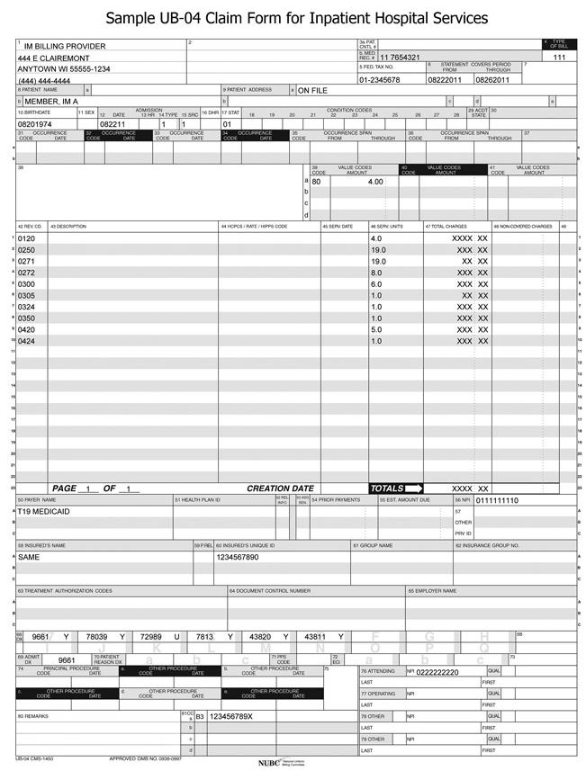
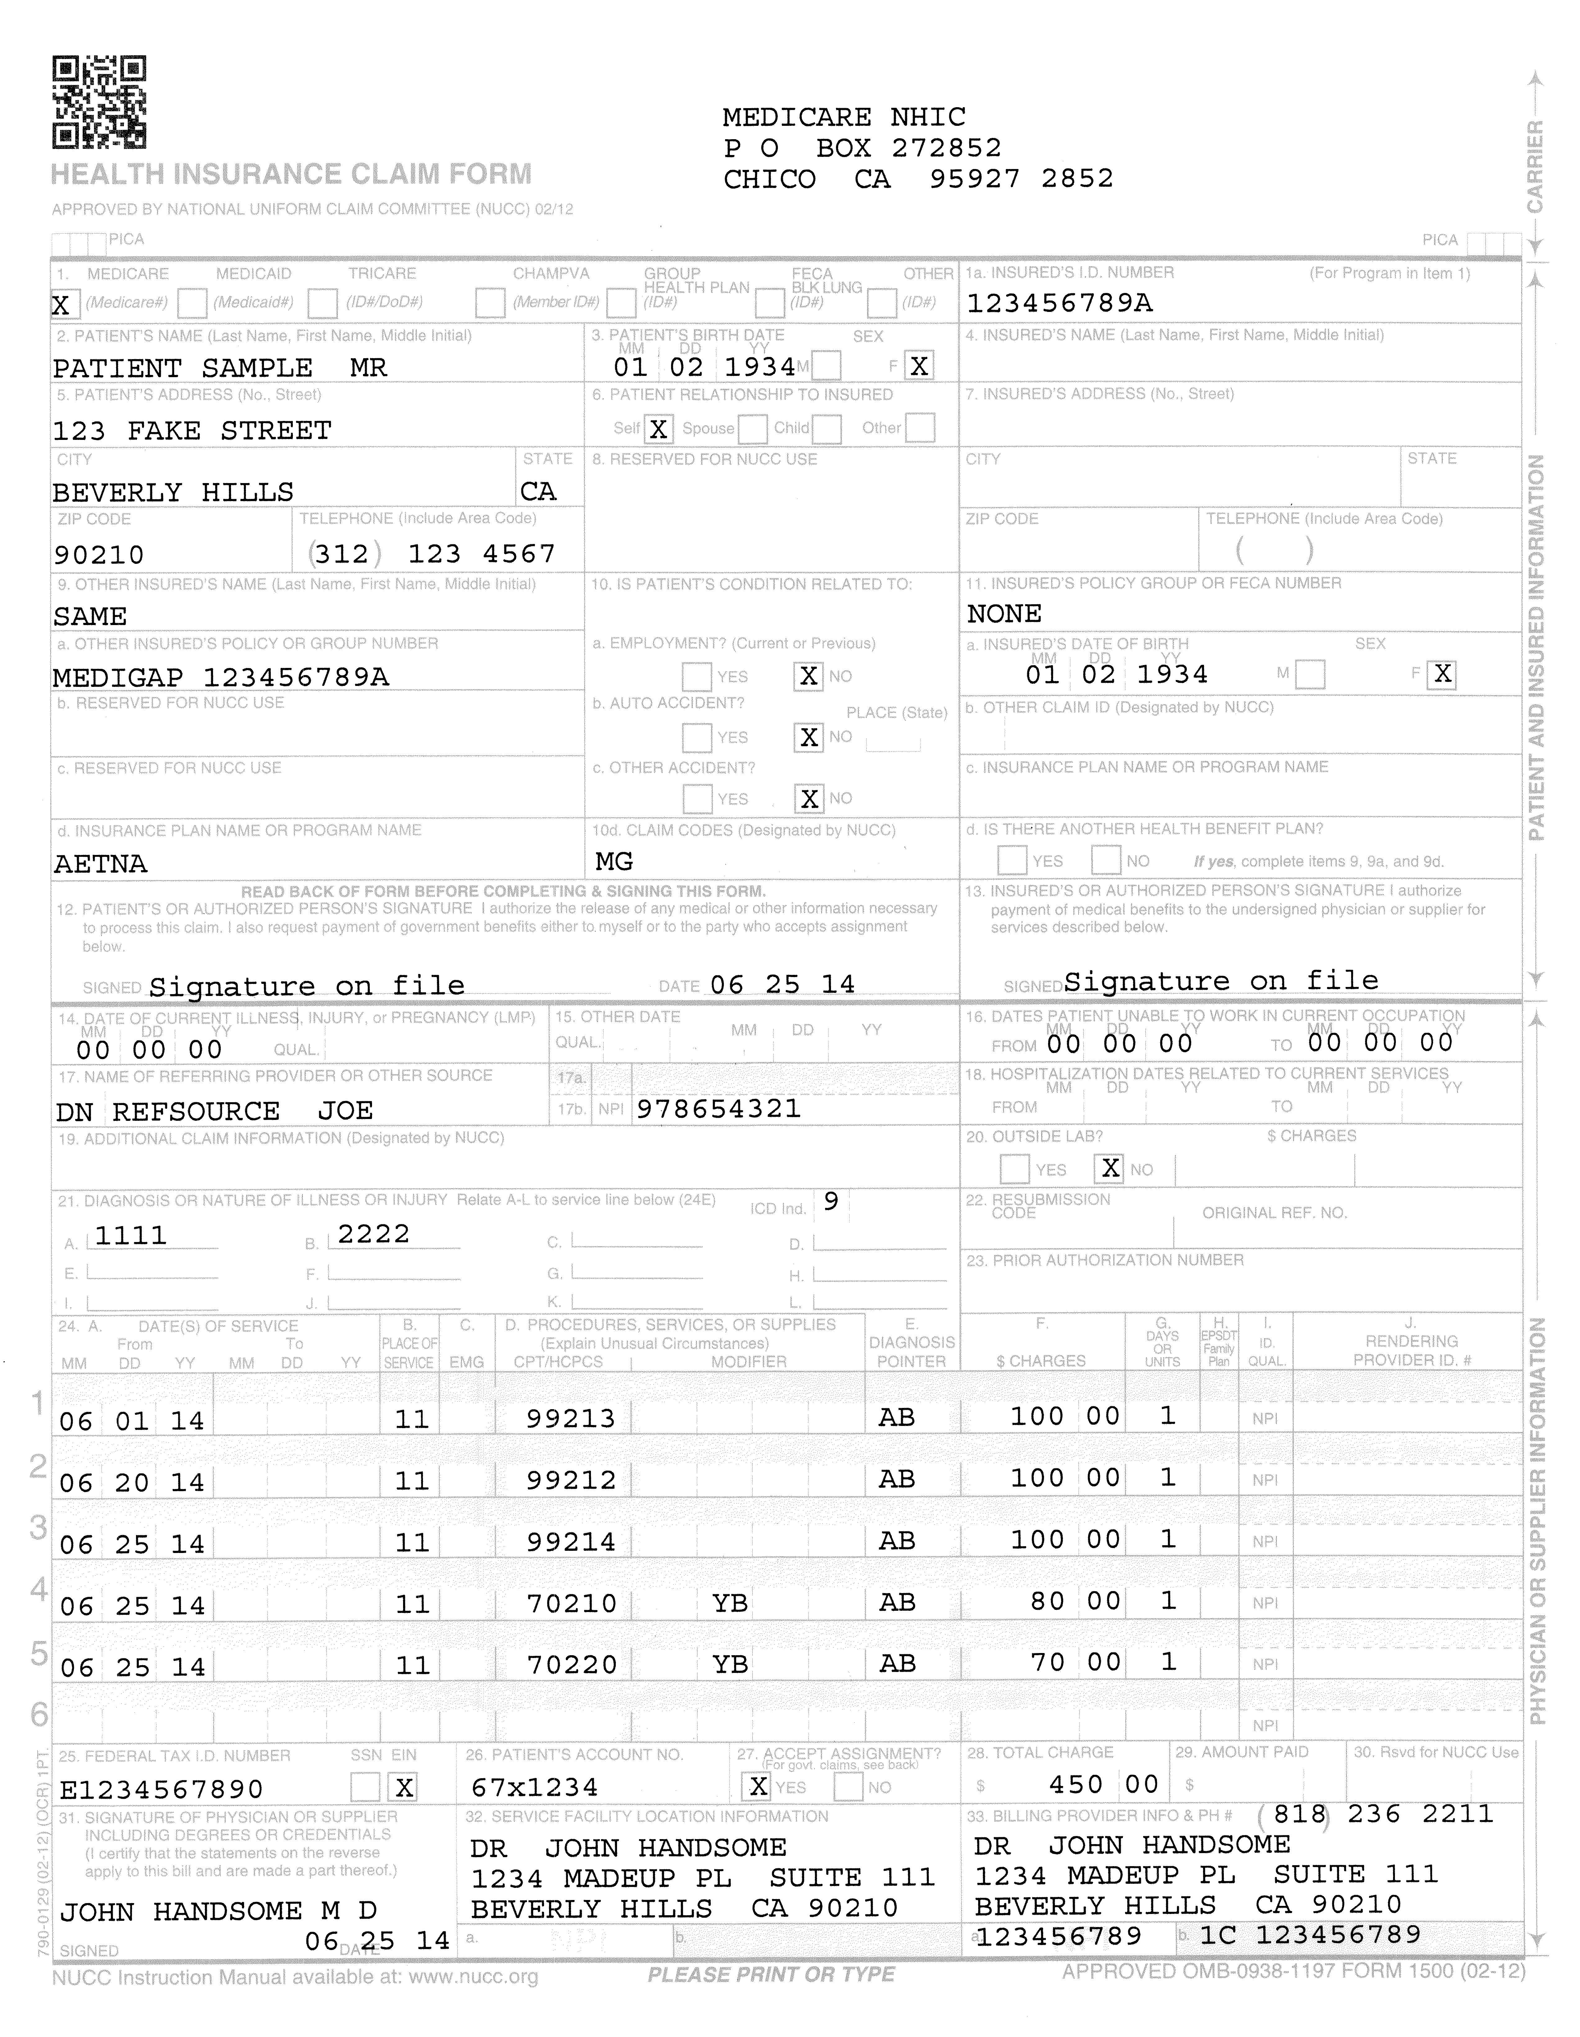
Example Claim Forms
Facility Claim: UB04 Form
Physician Claim: HCFA Form
All U.S. Insurance claims are submitted on one of these two forms.
Both forms have claim and line information.
Notes:
The claim and line fields are created because they are products of the forms where the data originated.

Slide 23
Origination of Claim and Line Fields: HCFA Form (Physician Claims)
Ex. Claim |  | Billing Dates | 04/09/2014 | - | 11/18/2014
DIAG#1 | DIAG#3
DIAG#2
04/09/2014 | 05/09/2014 | HCPCS#1 | $1,000 | #1 | $500
10/07/2014 |  | HCPCS#2 | $100 | #1 | $60
11/18/2014 |  | HCPCS#3 | $70 | #2 | $40
 |  | Charged: | $1,170 | Paid: | $600
Definition:
Claim = set of charges a provider bills to Medicare at once: The invoice.
Line = one specific charge a provider bills to Medicare
Most claim fields have an accompanying line field that stores different information (i.e. dates, diagnoses, etc)
Fields specific to line fields: procedure codes
Claim information in GREEN Line information in RED

Slide 24
Origination of Claim and Line Fields: UB04 Form (Facility Claims)
Ex. Claim |  | Admit Date | 04/09/2014 | Discharge | 11/18/2014
DIAG#1 | DIAG#3
DIAG#2
PROC#1 | 04/09/2014 | PROC#2 | 10/07/2014 | PROC#3 | 11/18/2014
DRG |  | Charged: | $1,170 | Paid: | $600
Definition:
Claim = set of charges a provider bills to Medicare at once – The invoice
Line = one charge a provider bills to Medicare
Most fields available on facility claims are claim fields
Fields specific to line data: procedure code and date
Claim information in GREEN Line information in RED

Slide 25
Claim vs Line Questions - ETL
What information to ETL?
Line information is the most specific information
The fields are required for reimbursement – physicians are forced to enter in this information so it is most complete.
Limited to the number of diagnoses to reference to a procedure – are we getting the whole picture?
Claim information is the most broad but dependent on the provider’s choice of including on claim
What to do with claims that do not have line information?
Inpatient, outpatient, hospice and home health claims do not have line item diagnoses – ok to use claim diagnoses?
Some procedures billed by facilities do not have line item dates (aka dialysis claims) – ok to use claim billing dates?
Use admit and discharge dates for claims that do not have line item dates for diagnoses?
What to do with claims that do not have a discharge date – aka SNF claims?
Current research algorithms are based on claim information
How can we recreate results from published data if we do not ETL claim diagnoses?
How does this change prevalence and incidence cases in published results?

Slide 26
More ETL Issues with Medicare
Combining facility and physician claims
In our ETL, each claim creates it’s own visit occurrence
When an outpatient facility claim and the accompanying physician claim is billed for the same procedure, it could look duplicative
Outpatient facility claims usually bill with the same HCPCS codes physicians use
CDM shows duplicate visit occurrence and procedure occurrence records
Should we specify facility vs physician claims somewhere in CDM?
Should we find some way to combine claims into one visit occurrence?
Could match claims by physician ID across Outpatient Facility and Physician files
Outpatient Facility file contains up to 3 physicians (SEER specific)
Physicians have at least 2 possible ids (NPI, UPIN)
A lot of our algorithms make a specification between looking at facility or physician file
SEER Inpatient claims do not carry the physician id. Would have to match on a number of conditions:
Physician claim place of service
Line item date on physician claim within the date range on the inpatient claim
Matching of procedures? ICD9 vs HCPCS billing

Slide 27
More ETL Issues with Medicare
Facility claims without End Dates
This currently affects how we create dates for the Visit Occurrence file (one claim = one visit occurrence)
SNF claims are billed without a discharge date – regularly billed every 60-90 days
How to interpret this date range?
Revenue codes stored Procedure Cost vs Procedure Occurrence files
Revenue codes include information for procedure information – revenue code 0331, 0332, 0335 = chemotherapy procedure done.
They also have a specific date assigned to them.
This is submitted at the time of submitting the claim

